Slide 1
An Introductory Powerpoint: Fahrenheit 451 by Ray Bradbury
The temperature at which book paper catches fire and burns

Slide 2
Fahrenheit 451
1947 – began as “Bright Phoenix” which contained seed for…
1951 – “The Firemen,” a short story published in Galaxy magazine and expanded…
1953 – Fahrenheit 451, a novel written at a time when the world was threatened by nuclear war, new technologies were emerging, and the world was getting smaller due to technology.

Slide 3
Concepts Related to Fahrenheit 451:
Social criticism: mode of criticism that addresses malicious conditions in a society considered to be flawed and aims at practical solutions.
Fahrenheit 451 warns against the dangers of suppressing thoughts and ideas through censorship
Science fiction: a form of fantasy in which scientific facts, assumptions, or hypotheses form the basis of adventures in the future, on other planets, in other dimensions in time, or under new variants of scientific law
Fahrenheit 451 conveys a message that oppressive government, left unchecked, can do irreparable damage to society by limiting the creativity and freedom of its people.

Slide 4
Additional Concepts
Totalitarian society – a society centrally controlled by an autocratic leader with strict control of all aspects of life and subordination of the individual to the state
Dystopian society – an imagined place or state in which everything is unpleasant or bad
*Propaganda is used to control citizens.
*Information, independent thought, & freedom are restricted.
*A figurehead or concept is worshipped by citizens.
*Citizens feel trapped & struggle to escape.
*The natural world is banished & distrusted.
*Citizens are dehumanized.
*The society is an illusion of a perfect utopian world.

Slide 5
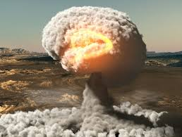
Historical Context What Was Happening in the World in the 1950s?
World War II had ended only a few years earlier.
Nuclear warfare loomed.
More jobs led to Americans having more discretionary income which led to increased passivity and conformity and the adage of: “Follow orders, and you will succeed.”
Era of McCarthyism brought new vigor to Truman’s hunt for Communist infiltrators.
Technology/electronics expansion included the use of televised surveillance footage for many purposes and the condensation of information into sound bites.
Illiteracy was growing.

Slide 6
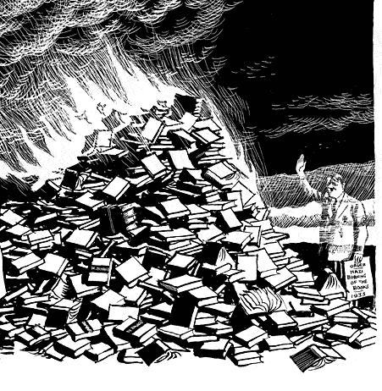
Lasting Effects of WWII
During Hitler’s power reign, he burned many books.
The Soviet Union banned and burned many books.
Communist China burned many books.
The novel condemns this anti-intellectualism.

Slide 7
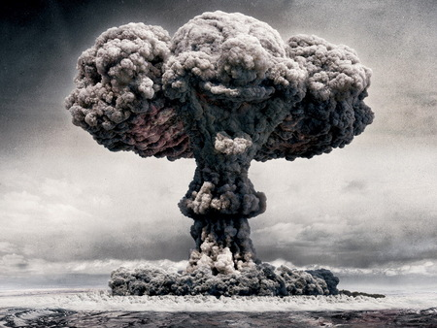
Threat of Nuclear War
Following WWII and the use of the atomic bomb, the nation and the world lived in fear of a nuclear war.
Bomb shelters built.
Warning systems initiated.
Drills in schools practiced.

Slide 8
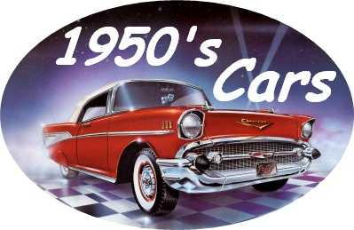
Consumerism = Success
60% of Americans was now middle class.
The US became an automobile culture.
Prosperity increased due to plentiful jobs.
Prosperity and conformity increased.

Slide 9
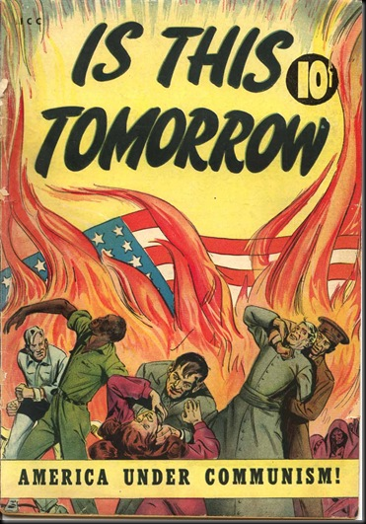
McCarthyism and The Cold War
Senator Joseph McCarthy took advantage of fear and distrust about the spread of communism, which was a contrast to America’s democracy.
He and his committee conducted this modern day witch-hunt by accusing random people of being Communists (disloyalty, subversion, and treason) and spreading hate propaganda without proper regard for evidence.
As a result many questioned the integrity of the government and its power over the people and forced interference into their private lives.
In 1953, Bradbury said, “ Some nights, when the wind is right, the future smells of kerosene.”

Slide 10
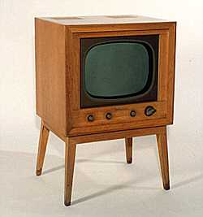
Expansion of Technology & Electronics
Television had a widespread impact on American life.
*1945 – Fewer than 10,000 TV sets existed in the US.
*1950 – More than 6 million TV sets existed in the US.
*1960 – More than 60 million TV sets existed in the US.
The electronic industry became the 5th largest industry.
McCarthyism used television to conduct his anti-communist witch-hunt.
Technology made the world so much smaller.
Information was now condensed into “sound bites.”

Slide 11
PREVENT
PREDICT
Bradbury
claimed he
was trying
to prevent
the future,
not
predict it.
However, he did anticipate the future:
Seashell radios
Parlor walls
Interactive TV
Population explosion
Rise in violence
Growing illiteracy
Condensation of information
Dehumanization & impersonalization of life
Elimination of books
Loss of meaningful interaction with others
Surveillance by police and government
Reliance on technology to mediate all social experiences

Slide 12
TWO CENTRAL THEMES
CENSORSHIP
IGNORANCE VS KNOWLEDGE
The suppression of speech or deletion of communicative material which may be considered objectionable, harmful, sensitive, or inconvenient by a controlling group.
In the novel, it is ironic that censorship begins with the people not the government.
Ironically, Bradbury discovered that editors had censored language in 75 sections without his knowledge and consent.
Without the ability to think, people can not make wise decisions.
Is ignorance bliss, or do knowledge and learning provide true happiness?
In Fahrenheit 451 firemen promote ignorance by destroying books – and with them – knowledge.

Slide 13
ADDITIONAL THEMES
Individual self-expression is important.
Censorship deprives self-expression.
Violence is self-destructive.
Mindless pleasure-seeking & materialism makes
for an empty life.
Humanity has the ability to be reborn or revived.
In the wrong hands, modern technology can be dangerous.
Commercialism can erode or overpower spiritual values.
People lose their humanity if they are not able to communicate and interact with each other on a personal level.
Humanity should preserve and value the culture of the past.

Slide 14
IN THE NOVEL:
Books are considered dangerous and therefore are illegal.
No one can own books.
Most people strive for happiness which they find through being plugged into their technology, where they do not have to think too hard.
Firemen do not stop fires; they start them. They are the happiness squad. They destroy books when found and often the homes of those who have the contraband.

Slide 15
SETTING IN THE NOVEL
TIME: Future – Bradbury identifies the time period as 1999; Granger, a character from Part III mentions the atomic bomb’s destruction 50 years ago; other scholars identify time as 24th century
PLACE: America; Montag’s cold & violent city; the firehouse, Montag’s home (mausoleum-like), Faber’s home, simple forest
ATMOSPHERE: A repressive government censors all literature, citizens lives are filled with trivial distractions, people desire happiness in any way they can obtain it, technology rules, war is imminent, and people do not think for themselves.

Slide 16
INTERNAL CONFLICTS IN THE NOVEL
Man vs himself
1. Montag and his struggle to overcome his violent past and going against the tenets of his profession
2. Faber overcoming his fears and helping Montag

Slide 17
EXTERNAL CONFLICTS IN THE NOVEL
Man vs society
Montag vs society
Clarisse McClellan vs society
Professor Faber vs society
Man vs man
Montag vs Beatty
Montag vs Midlred

Slide 18
SYMBOLS IN THE NOVEL
Phoenix
The Hearth and the Salamander
The Sieve and the Sand
Mechanical hound
Old woman
Mirrors
Birds
Captain Beatty
Mildred
Montag
Books

Slide 19
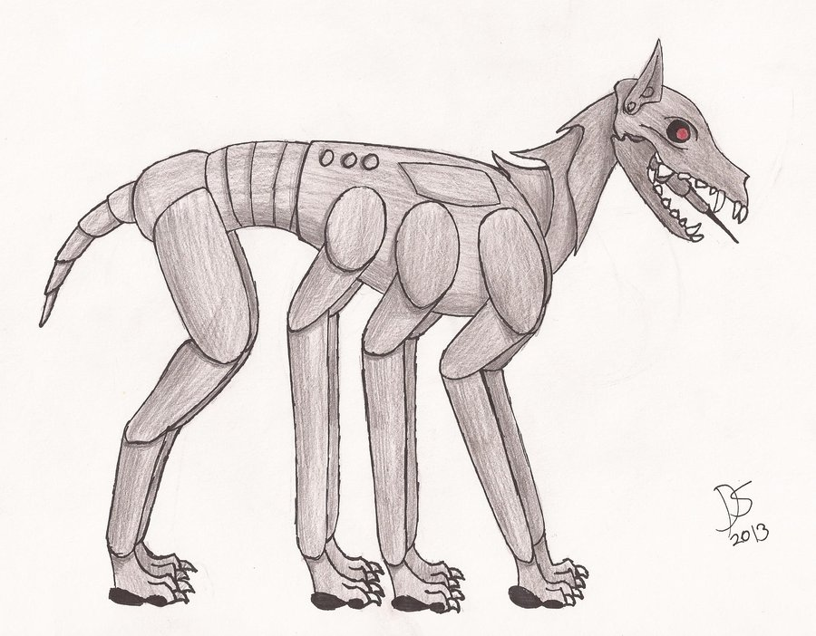
CHARACTERS IN THE NOVEL
Guy Montag
Mildred Montag
Captain Beatty
Professor Faber
Clarisse McClellan
Granger
Mrs. Phelps
Mrs. Bowles
Old Woman
Mechanical Hound
Stoneman and Black
Book People

Slide 20
POINT OF VIEW
Third Person
Limited Omniscient -
Montag’s thoughts and feelings

